Slide 1
ENSE 470, Milestone 5
Group Eh?
Nickolas Schmidt, Quinn Bast, Abdulaziz Alghamdi,
March 15th 2018

Slide 2
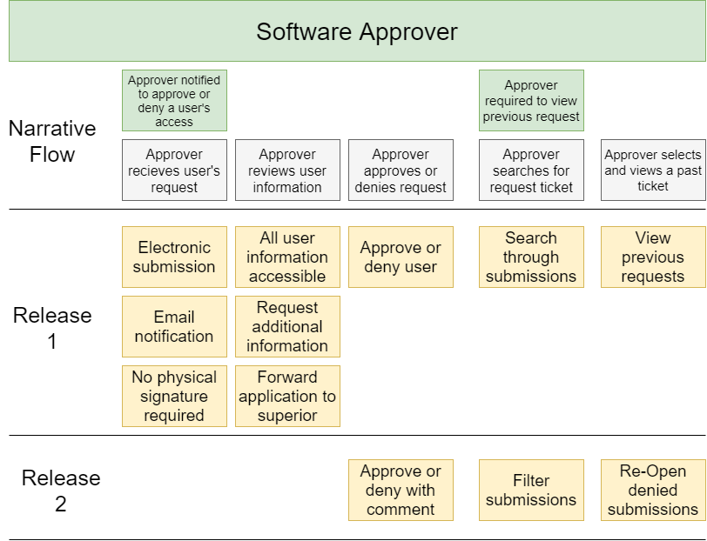
Software Approver ATDDs

Slide 3
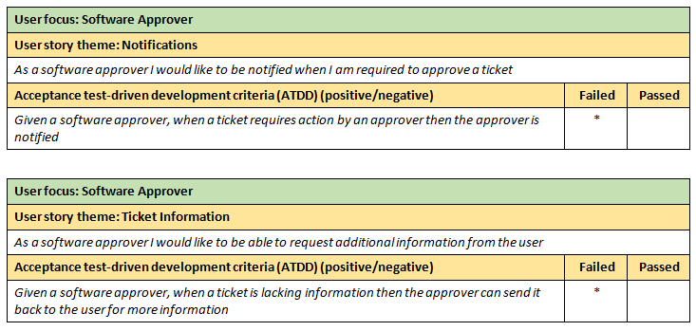
Release 1 ATDDs

Slide 4
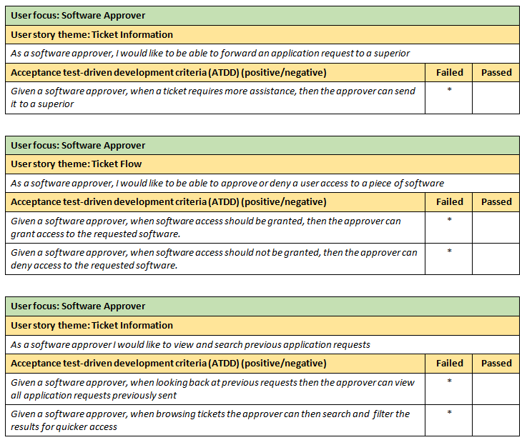
Release 1 ATDDs

Slide 5
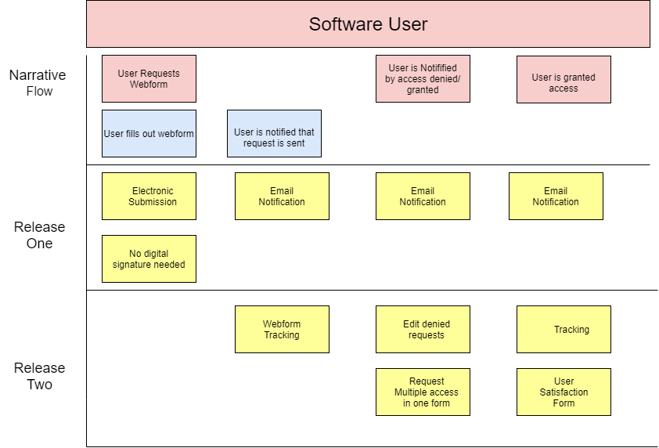
Software User ATDDs

Slide 6
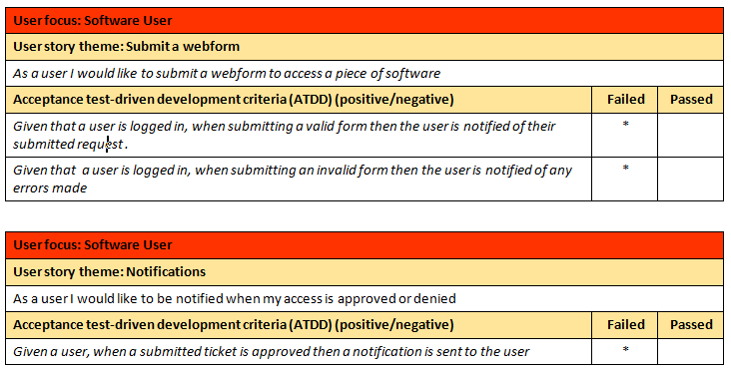
Release 1 ATDDs

Slide 7
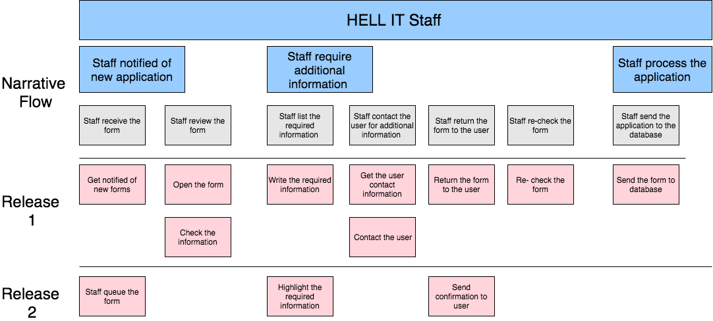
Hell IT Staff ATDDs
Reflections & Changes:
The Hell IT Staff have no responsibilities in the new system and all actions are done by the Software Approver.
This User story map was scrapped on this iteration and no ATDDs were required for the Hell IT Staff.

Slide 8
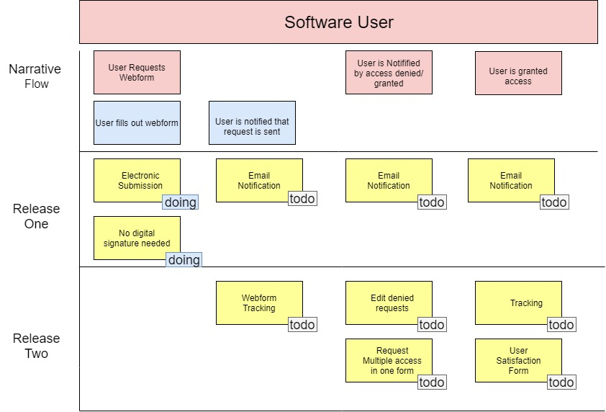
Daily Scrum

Slide 9
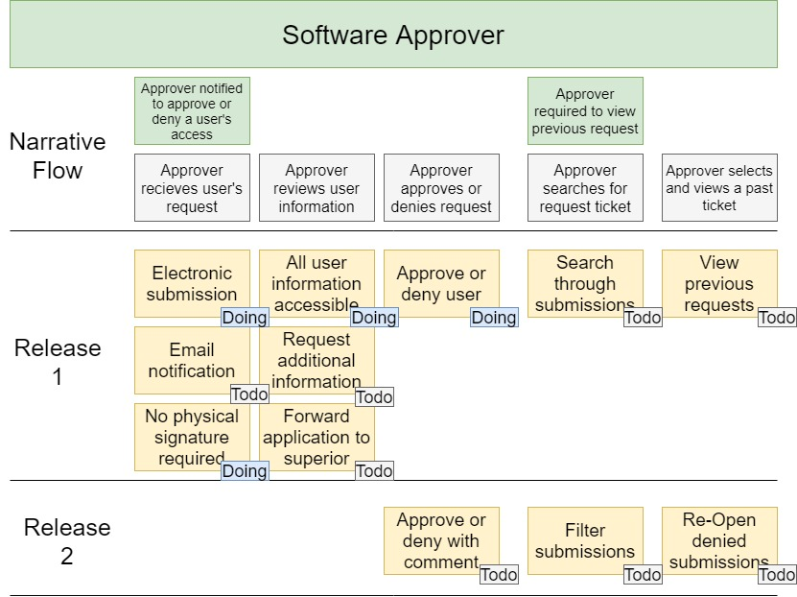
Daily Scrum

Slide 10
Daily Scrum
http://142.165.187.167/pages/login.php

Slide 11
Group reflection
How did you feel about this milestone? What did you like about it? What did you dislike?
Was a nice milestone. Acceptance-Test Driven development helped us to start planning the interface and program design.
What did you learn about yourself as you collaborated and worked through this milestone?
We learnt it is never a bad idea to change/refactor your design during the planning stages of the project.
How will you use what you have learned going forward?
We learnt how to create ATDDs and use our tests to gauge progress.
What “stuff & things” related to this milestone would you want help with?
Now starting to create the website, we would like to know how to apply the design patterns we have learnt to a web application. We have one class on web design and have no clue how to apply the patterns from this class to a LAMP stack.

